Slide 1
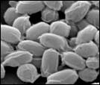
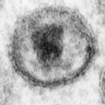
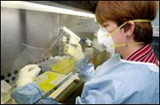
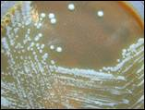
Infectious Diseases

Slide 2
IMMUNITY
First Line of Defense

Slide 3
Stomach Acid | Kills pathogens that have been swallowed due to low pH level.
Skin | Skin forms a waterproof mechanical barrier.
Tears Mucus Saliva | Mucus trap pathogens. Contain enzymes that can break down pathogens.
Diarrhea and vomiting | Pathogens are removed from the body by these processes.
Urine flow | Flushes out pathogens from the bladder area.
Done: think about how you will show these in your comic strip

Slide 4
Second Line of DefenSe

Slide 5
Second Line of DefenSe
Inflammation: increases the permeability of the blood vessels to allow white blood cells to leave and attack the pathogen

Slide 6
WHITE BLOOD CELLS
ARE ALL RELEASED FROM LYMPH NODES.

Slide 7
Second Line of DefenSe
White Blood cells: Neutrophils and Macrophage

Slide 8
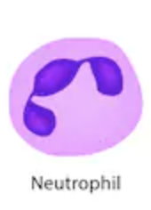
Neutrophils:
These cells attack bacteria.
First to the infection site
Engulf the bacteria (“eat” the bacteria)
Easily killed
Only last a few days in the body

Slide 9
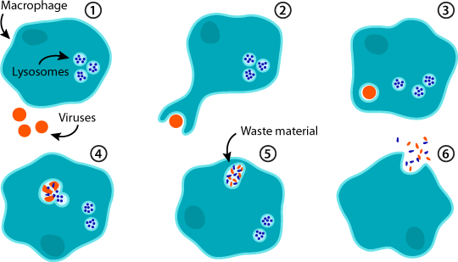
Macrophages:
Macrophage means ‘big eater’.
These cells engulf pathogens (not just bacteria)
Also clean up the mess of dead cells by engulfing them.

Slide 10
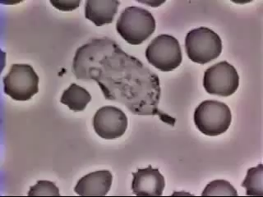

Slide 11
THIRD Line of Defense

Slide 12
White Blood Cell: Lymphocytes
They produce antibodies that are used to attack invading pathogen and destroy them.
Make memory cells to remember the pathogen next time

Slide 13
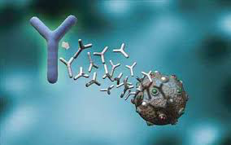
Types of Immunity

Slide 14
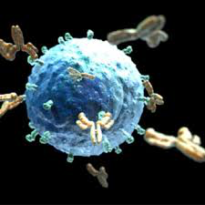
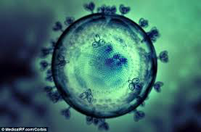
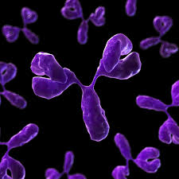
Natural Immunity
No medical intervention helps you become immune

Slide 15
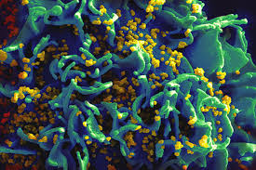
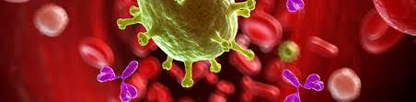
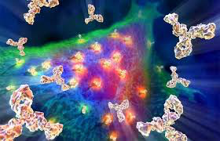
Artificial immunity
Medical intervention helps you become immune

Slide 16
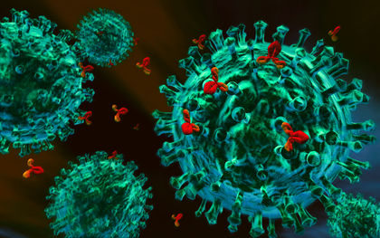
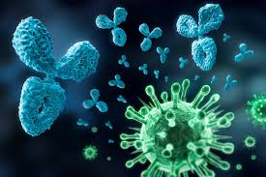
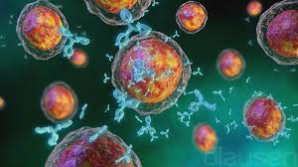
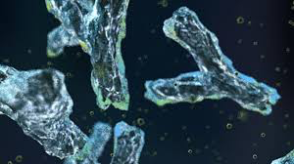
Passive immunity
Antibodies are NOT produced by own immune system
No memory cells produced
Notes:
In activity book blank out segments!

Slide 17
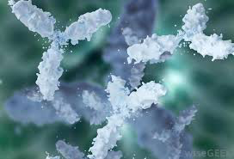
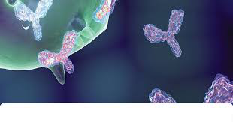
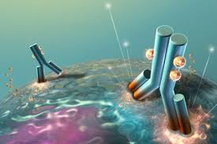
Active Immunity
Antibodies produced by own immune system
Memory cells produced

Slide 18
AGAIN?
Passive = your body doesn’t make antibodies
Active = your body makes antibodies
Natural = no doctor
Artificial = help from doctor

Slide 19
EXAMPLES
 | Natural | Artificial
Active | You get sick and make antibodies | You get immunised and make antibodies
Passive | You get antibodies from mother breast milk | An injection/transfusion of antibodies

Slide 20
John is 1 year old . He drinks his mothers breast milk. He has natural and passive immunity.
John goes to school and meets Billy. Billy is sick. John is now sick. John has natural and active immunity.
John receives a letter from the school. He must get immunised. John has artificial and active immunity.
John is very ill. He isn’t making his own antibodies. John gets an injection of antibodies from lifelong friend Billy. John has artificial and passive immunity.

Slide 21
Ben is a baby. He is hungry. He has some breastmilk. He is passive and natural immune.
Maui is sick. He gets Ben sick. Ben is active and natural immune.
Ben gets a letter from his school. He needs to be immunized. He is active and artificial immune.
Ben is very ill. Maui is Ben’s life long friend. Maui gives Ben his antibodies. He is passive and artificial immune.

Slide 22
EXAMPLES in picture form
Natural and Active:
Natural and Passive:

Slide 23
EXAMPLES in picture form
Artificial and Active:
Artificial and Passive:

